Slide 1
EPO Anniversary Event:
The State of Electoral Hostility
---
Houses of Parliament
2 February 2023
Michael Bruter

Slide 2
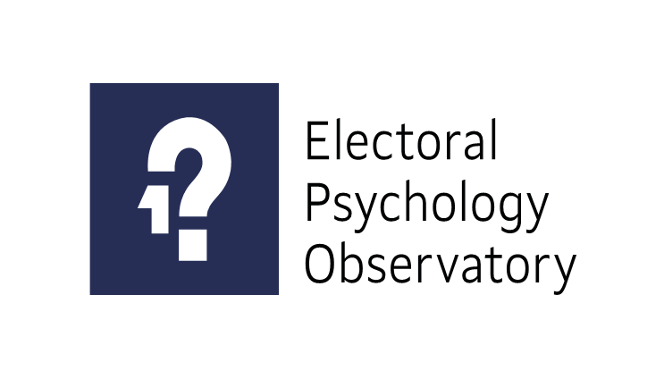
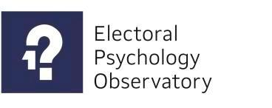



Overview
Happy Global Elections Day!
Happy 3rd EPO anniversary!
Thanks to our Chairs and guests
Thanks to the ERC and the ESRC
Celebrating ESRC Best International Impact Award

Slide 3
Methodology
Election studies: 27 countries including 7 core
Core: Parallel surveys of general population and first time voters
Open end, explicit, and implicit questions
Hostility Barometer: EPO and Opinium UK and US
Family focus groups
Individual interviews and first time voters interviews
Experiments and quasi-experiments
Coding of electoral atmosphere

Slide 4
Conceptual questions
What is electoral hostility? (and what is it not)
How widespread is it and how is it evolving?
How does it translate in people’s every day life?
Who do citizens blame for it?
What are the political and societal consequences of hostility?
What are the risks of hostility in terms of social cohesion, solidarity, and hopelessness?

Slide 5
What is hostility?
Hostility grows on an identity “triangle” based on our perceptions of others, of how we think others see us (mirror perceptions) and perceptions of how society works and how it is evolving.
Hostility is not polarization
Hostility goes beyond partisanship, polarisation, or issues. It is about incompatible moral perceptions and visions of what society is and should be. It is unlikely to go anywhere in either the US or UK
Hostility is a cycle of perpetually deteriorating emotions: it gets worse unless it gets better
Hostility can translate into attitudinal and behavioural (e.g. unfriending, insults, or even threats or physical violence) reactions
Hostility can lead to democratic frustration (Harrison) and hopelessness (Bruter)
Hopelessness is a terrifyingly disinhibiting: “things are so bad they probably can’t get worse anyway” opens every dangerous door

Slide 6
What is hostility?
Hostility grows on an identity “triangle” based on our perceptions of others, of how we think others see us (mirror perceptions) and perceptions of how society works and how it is evolving
MIRROR PERCEPTIONS
PERCEPTIONS OF OTHERS
PERCEPTIONS OF SOCIETY

Slide 7
What is hostility?
Hostility is not polarization
Hostility goes beyond partisanship, polarisation, or issues. It is about incompatible moral perceptions and visions of what society is and should be. It is unlikely to recede of its own
AFFECTIVE POLARISATION | HOSTILITY
Stems from “excessive” in group identity | Outgroup animosity does not entail ingroup identity
Relates to partisan (possibly issue) identification | Relates to irreconcilable conceptions of what society is and should be
Genesis: 1) people identity with party, 2) those identities become increasingly strong and polarised, 3) identification with party becomes identification with partisans 4) identification with ingroup becomes rejection of outgroup | Genesis: 1) Increasing proportions of people are critical of how society works, 2) This has first led to animosity towards politicians and elites, later towards institutions, and now towards regular citizens, 3) animosity deteriorates
The more partisan people are the most likely to be hostile. Hostility is always towards the furthest ideology | You can be hostile without being partisan, even without caring about politics Hostility can expand from opposite to close voters/worsen

Slide 8
What is hostility?
Hostility is a cycle of perpetually deteriorating emotions: it gets worse unless it gets better
Hatred
Contempt (demobilising)
And/or
Disgust
(mobilising)
Anger
Distrust
Frustration
Misunderstanding

Slide 9
An emotional sliding scale

Slide 10
Perceived evolution of hostility
Citizens see electoral hostility as significantly deteriorating (4.16 in South Africa to 5.47 in the US)

Slide 11
Who is blamed for hostility?
Citizens primarily blame both extremist (6.49) and mainstream (6.27) politicians for hostility. However, they also blame both opposite (5.49) and like-minded (4.92) voters and to an extent even themselves (4.40)

Slide 12
What does hostility mean in real life?
Hostility can translate into attitudinal (e.g. dismissive: 68.7%, 68.6% angry) and behavioural (e.g. insults: 61.1% or even threats: 44.2%) reactions.

Slide 13
Social consequences of hostility
People consider ostracising others due to electoral differences. 38% would consider no longer inviting them for dinner, 37.7% never speaking again, 31.1% physical fight

Slide 14
Political consequences of hostility
Around half of citizens consider that those who vote for a party they don’t support should exclusively suffer the social, political and public service consequences of their vote

Slide 15
The threat to solidarity
Across countries between half and 2/3 would resent paying taxes to protect opposite voters when affected by policies they voted for.

Slide 16
The danger of hostility
Hostility can have very dangerous consequences:
It can threaten DEMOCRATIC RESOLUTION – the sense that elections can bring closure to societal divisions;
It can threaten the willingness of citizens to engage in SOLIDARITY with each other.
It can lead to DEMOCRATIC FRUSTRATION (Harrison)
It can lead to HOPELESSNESS (Bruter) – a highly disinhibiting emotion which can lead citizens to consider behaviours they do not believe are “solutions” themselves

Slide 17
Thank you!

Slide 18
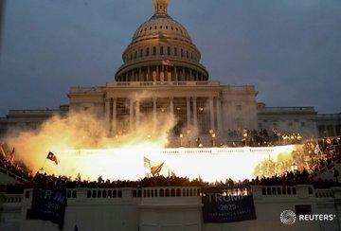

Slide 19
EPO Election Studies and
EPO-Opinium Hostility Barometer
Election studies: 27 countries including 7 core
Core: Parallel surveys of general population and first time voters
Core: Multi-year panel studies
Open end, explicit, and implicit questions on hostility, frustration, atmosphere, emotions, memory, personality, behaviour, with separate ergonomics coding
Typical samples 2,000 for general population + 500 first time voters survey
Hostility Barometer: Regular joint operation by EPO and Opinium
UK: started May 2019, 7 waves so far
US: started May 2020, 2 waves so far
Mix of time series core + wave-specific modules (frustration, elections under covid, Christmas dinners, electoral ergonomics, etc)
Typical samples 2,000 with panel study component

