Slide 1
Dr Sandra Obradović
Electoral Hostility:
Examining electoral atmosphere and perceptions of others voters in South Africa, Sweden and the UK

Slide 2

Overview
Key questions: In their own words…
  How do voters experience the atmosphere around an election?
  How do they perceive other voters who voted differently?
Data
  Nationally representative survey data from the UK (2019), South Africa (2020) and Sweden (2022)

Slide 3
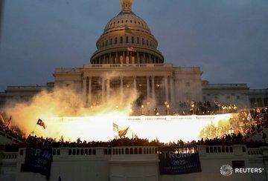
Electoral atmosphere
“Now please think of the election that took place recently. Please, list the first word that comes to your mind when you think of the atmosphere of the election.”

Slide 4
Electoral atmosphere: UK – Key words

Slide 5
Electoral atmosphere: SWE – Key words

Slide 6
Electoral atmosphere: UK
Negative: Bad, Childish, Chaos, Difficult, Dividing, Disappointing, Hateful, Messy, Sinister, Gloomy etc.
Positive: Curious, Finally, Fun, Happy, Excited, Hopeful, Good, Nice atmosphere, Safe
Neutral: Even (race), Change of power, Different
Total coded: 1808

Slide 7
Electoral atmosphere: Positive v Negative
UK
Sweden
Total coded: 1808
Total coded: 836

Slide 8
Electoral atmosphere: Intense v. Relaxed
UK
Sweden
*Intense could be both positive (‘electric’) and negative (‘chaotic’)…

Slide 9
Electoral atmosphere: Intense v. Relaxed
UK
Sweden
*Intense could be both positive (‘electric’) and negative (‘chaotic’)… although predominantly negative

Slide 10
Perceptions of other voters
“Regardless of how you voted in the election, when you think of those people who voted for the outcome that you LEAST agree with, what is the first word that come to your mind?”

Slide 11
Perceptions of other voters [decision]

Slide 12
Perceptions of other voters [decision]
Democratic right:
Emphasizing that a right to have a choice, and to vote differently, is part of democracy
“Democratic” , “Their choice” , “Everyone is allowed to choose” , “Your vote is your choice”

Slide 13
Perceptions of other voters [decision]
Inferior cognition:
Emphasizing other voters limited intellect, or knowledge, to be able to make informed and rational decisions
“Idiots” , “Ill-informed”, “mindless” , “Stupid” , “Unenlightened”

Slide 14
Perceptions of other voters [decision]
Negative emotional reaction:
Responses emphasizing negative feelings towards other voters or their decision, ranging from frustration to hatred
“Disappointed” , “Frustrated” , “Angry” , “Hatred”, “Disgusted”

Slide 15
Perceptions of other voters [decision]
Emotions driving vote:
Responses emphasizing the emotionality of other voters in their decision-making
“Emotionally driven without consequential thinking” , “Fearful” , “Bitter“ , “Emotional” , “Desperate”

Slide 16
Perceptions of other voters [decision]
Manipulated:
Other voters were seen as manipulated by politicians / media or other sources (not specified) into making [implicit] incorrect decisions
“Misled” , “Deceived”, “Brainwashed”, “Misguided” , “False promises”

Slide 17
Perceptions of other voters [decision]
Acceptance:
Similar to democratic right but focus is not on rights to choose but rather acceptance of difference
“I understand” , “At least they voted” , “Maybe its for the best” , “I'm fine with it, half my family voted Tory I don't mind”, “Happy that we’re all individuals”

Slide 18
Perceptions of other voters [decision]
Acceptance:
Similar to democratic right but focus is not on rights to choose but rather acceptance of difference
“I understand” , “At least they voted” , “Maybe it’s for the best” , “I'm fine with it, half my family voted Tory I don't mind”, “Happy that we’re all individuals”

Slide 19
Conclusion
Electoral hostility is expressed both through our perceptions of the ‘public’ , the general atmosphere of an election and the way we see other voters
The atmosphere of election was predominantly experienced as negative within UK and Sweden, but positivity more strongly present in Sweden
  How do we harness excitement and reduce tensions and worry?
When thinking about others voters, citizens position their political choices as…
  Irrational
  Manipulated
This in turn justifies ‘our’ choice, and essentializes political differences as rooted in differences in ‘people’ (‘they’ are uneducated, ‘we’ are not; Obradovic & Draper, 2022)
  Important to consider where interpersonal and intergroup hostility becomes reproduced
…but also to a smaller degree, participants show an acceptance of diversity of opinions and the democratic right to exercise ones vote

Slide 20
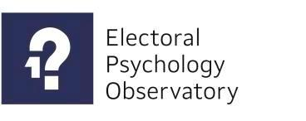





Thank you!

